Slide 1

Self-training for retourists
Sophie Llewellyn Smith

Slide 2
A PLAN FOR RETOUR SELF-TRAINING
Understand the required standard.
Diagnose your current performance (level, strengths, weaknesses).
Select suitable exercises to work on your weaknesses (technique + vocabulary & register)
Consider your timeline and create a timetable.
Set yourself up for success when doing interpreting practice.
Use AI to help.
Assess your performance.
[Record your progress (learning journal/Excel doc, etc.)]

Slide 3
UNDERSTANDING THE REQUIRED STANDARD
Know the market you’re aiming at.
Listen to interpreters working on this market.
Compare your performance to an interpreter who works successfully on this market (see below).
Get an opinion from an interpreter, or preferably trainer, in the field you’re aiming at.

Slide 4
COMPARING YOURSELF TO A STANDARD
Try interpreting the same speech as an experienced interpreter.
Use a speech with a transcript (e.g. Speech Repository) or create a transcript of both performances, using Word, Mac, Google doc; or dictation.io, or speech to text apps.
Compare the output. Did you leave more information out? Were there inaccuracies? How did your coping strategies compare?
What about prosody (fillers, hesitations, etc.)? E.g. go through and highlight all the ‘ums’ and ‘ers’, or lengthened vowels.
Are the pauses in the right place (you could hit ‘tab’ in your transcript to get a visual representation)?

Slide 5
DIAGNOSIS
Based on feedback from a native speaker, colleague, or your own recordings, see if you can identify patterns in your use of English, e.g. problems with prepositions, word order, pronunciation, collocations, articles, lack of vocabulary, register, etc.
Consider the results of a ‘stress test’.

Slide 6
PRIORITISING
Then prioritise these sources of error. Some may be noticeable and irritating for you, but not problematic for communication (e.g. ?accent, articles).
List the exercises/activities you could do to improve those areas (see below).
Remember that improving a retour is a long term project. Some of these things take months or years to improve, especially if they’re entrenched habits.
You could always ‘benchmark’ your progress by recording a couple of speeches, and going back to them several months later for another attempt. Compare the two versions.

Slide 7
EXERCISES – A BASIC PRINCIPLE
The exercises you choose must aim to activate your English B.
Reading the paper, listening to the radio, and watching TV are useful in their way (for example, in picking up buzzwords or listening to modern usage), but very passive. [They’re better for improving an English C).
You always need to go one step further and find an exercise that will make you practise coping strategies.

Slide 8
VOCAB ENHANCEMENT VS ACTIVATING A RETOUR
VOCAB ENHANCEMENT
Watching the news
Listening to podcasts
Reading the papers
Noting useful expressions
ACTIVATION
Summarising what you’ve heard
Making up example sentences
English > English reformulation exercises (text, interpreting)
Preparing your own speeches
Sight translation
? Shadowing (pronunciation esp.)

Slide 9
FUN & GAMES
Speak as much English as possible – conversation exchange (italki), clubs
Play games:
Articulate
Taboo
Just a Minute
‘Sentence finishing’ games

Slide 10
WORKING ON TECHNIQUE
Which techniques do you think are most called upon when working into your B language?

Slide 11
PRACTISING SIMPLIFYING/EDITING
With texts
Basic summary exercise (circle links, underline main ideas, cross out details). Give your summary out loud.
‘Highlighting exercise’ (B language) – see Andy Gillies (Conference Interpreting: a Practice Book)
Black marker exercise (B language)
With speech
Listen to a short podcast (B language). Give an oral summary.
Listen to a speech (B language). Press pause. What’s the shortest/simplest way you can reformulate the idea?
Listen to a speech on 0.75 speed (B language). Summarise each idea.
Do B>B reformulation from a video. Deliberately edit the speech to leave out redundancy, details, examples, etc.
NOTE: choosing source material in your B language turns these exercises into reformulation exercises as well.

Slide 12
PRACTISING SALAMI TECHNIQUE
With speech
Play a podcast or video (A or B). Tap the table every time you hear a unit of meaning.
Play a speech (A or B). Press pause after each unit of meaning. Reformulate the idea out loud as a standalone sentence.
Choose a relatively slow speech to interpret from A>B. Start every sentence in a different place from the speaker
Choose a wordy speaker if possible (A or B), and play the video on 0.75 speed. Chop the sentences into smaller pieces.
Play a speech (A). Lengthen your decalage at the beginning of each sentence/idea, to see whether you need to change the syntax or word order to create ‘open syntax’.
With texts
Choose a suitable text (A or B). Go through it with a pen, drawing a forward slash when you come to a unit of meaning.
Choose a suitable text (A or B). Go through it with a pen, drawing a forward slash when you come to a unit of meaning. Rephrase that idea out loud as a standalone sentence.
Sight translation (A>B), changing any subordinate clauses (e.g. relative clauses) into open syntax.
Sight translation (A>B), beginning every idea in a different place from the original.

Slide 13
PRACTISING REFORMULATION
With texts
Find two articles in your B on the same topic. Underline different expressions that mean the same thing.
Choose a suitable text in your B. Look for key words (nouns, verbs). What words go with them? What can you replace them with? Is it the same register? Does it still make sense? Use a collocations dictionary if necessary, e.g. http://www.freecollocation.com/search1?word=agree
With speech
Pick a speech (not too technical) for B>B reformulation. Key phrases stay the same; are you able to reformulate the rest?
Use a speech (in your B) to play with register. See if you can reformulate it to make it more or less formal.

Slide 14
Working on vocabulary and usage
LISTEN DIFFERENTLY
When listening to your A language, listen out for phrases that are hard to translate into English (culture specific, jargon, idiomatic). Think about how you would deal with them (keep a special notebook or document?).
When listening to English, be alert for useful phrases. Make a note of them. Then activate that vocabulary: at the very least, say them out loud a few times. Write a few sentences. Ideally, prepare a short speech incorporating several new/useful phrases or words.

Slide 15
Working on vocabulary and usage
GLOSSARIES
Word lists are difficult to retain, and don’t necessarily help you produce idiomatic ‘chunks’ of language.
When noting down useful vocabulary, write down whole phrases including useful syntax, e.g. what preposition follows a verb.
For key ideas (‘discrimination’, ‘proposal’, ‘legislation’), note it down with a list of a) suitable verbs and b) adjectives that collocate well with this term.
Keep your vocabulary arranged by topic so you are creating a semantic field for yourself.

Slide 16
Working on vocabulary and usage
WORD CLUSTERS
To enlarge your vocabulary, make it more subtle and nuanced, and be attentive to register, work with semantic ‘clusters’ of words. These words should be big ideas (usually oppositions such as big/small, agree/disagree, important, accept/refuse, good/bad, say, etc.)
Take a sheet of paper and write your key concept in the middle. Now brainstorm all the synonyms you know; write them vertically next to or around your key word, with higher register words at the top, and more informal vocab at the bottom. Annotate any words with a special nuance (e.g. pejorative). If you like, invent/write down your symbol for this particular concept.

Slide 17
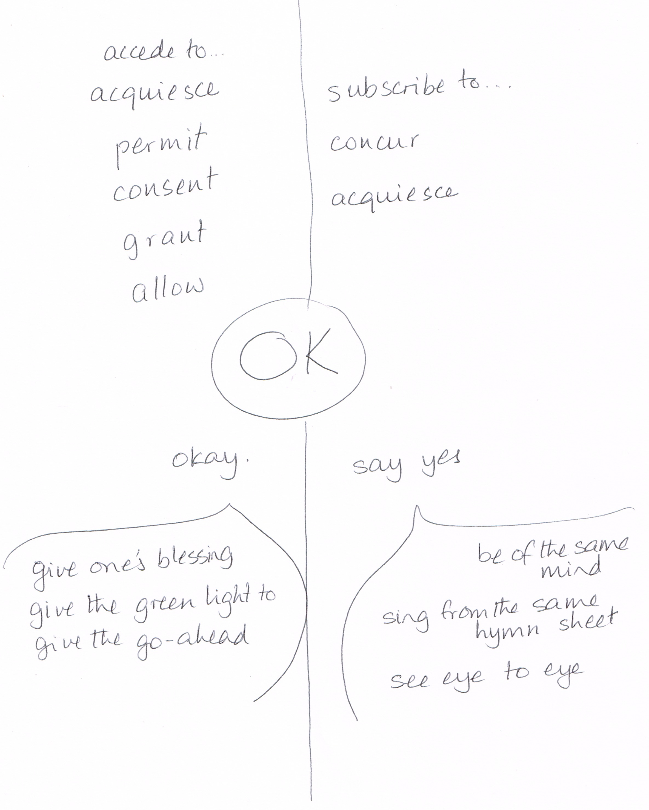

Slide 18
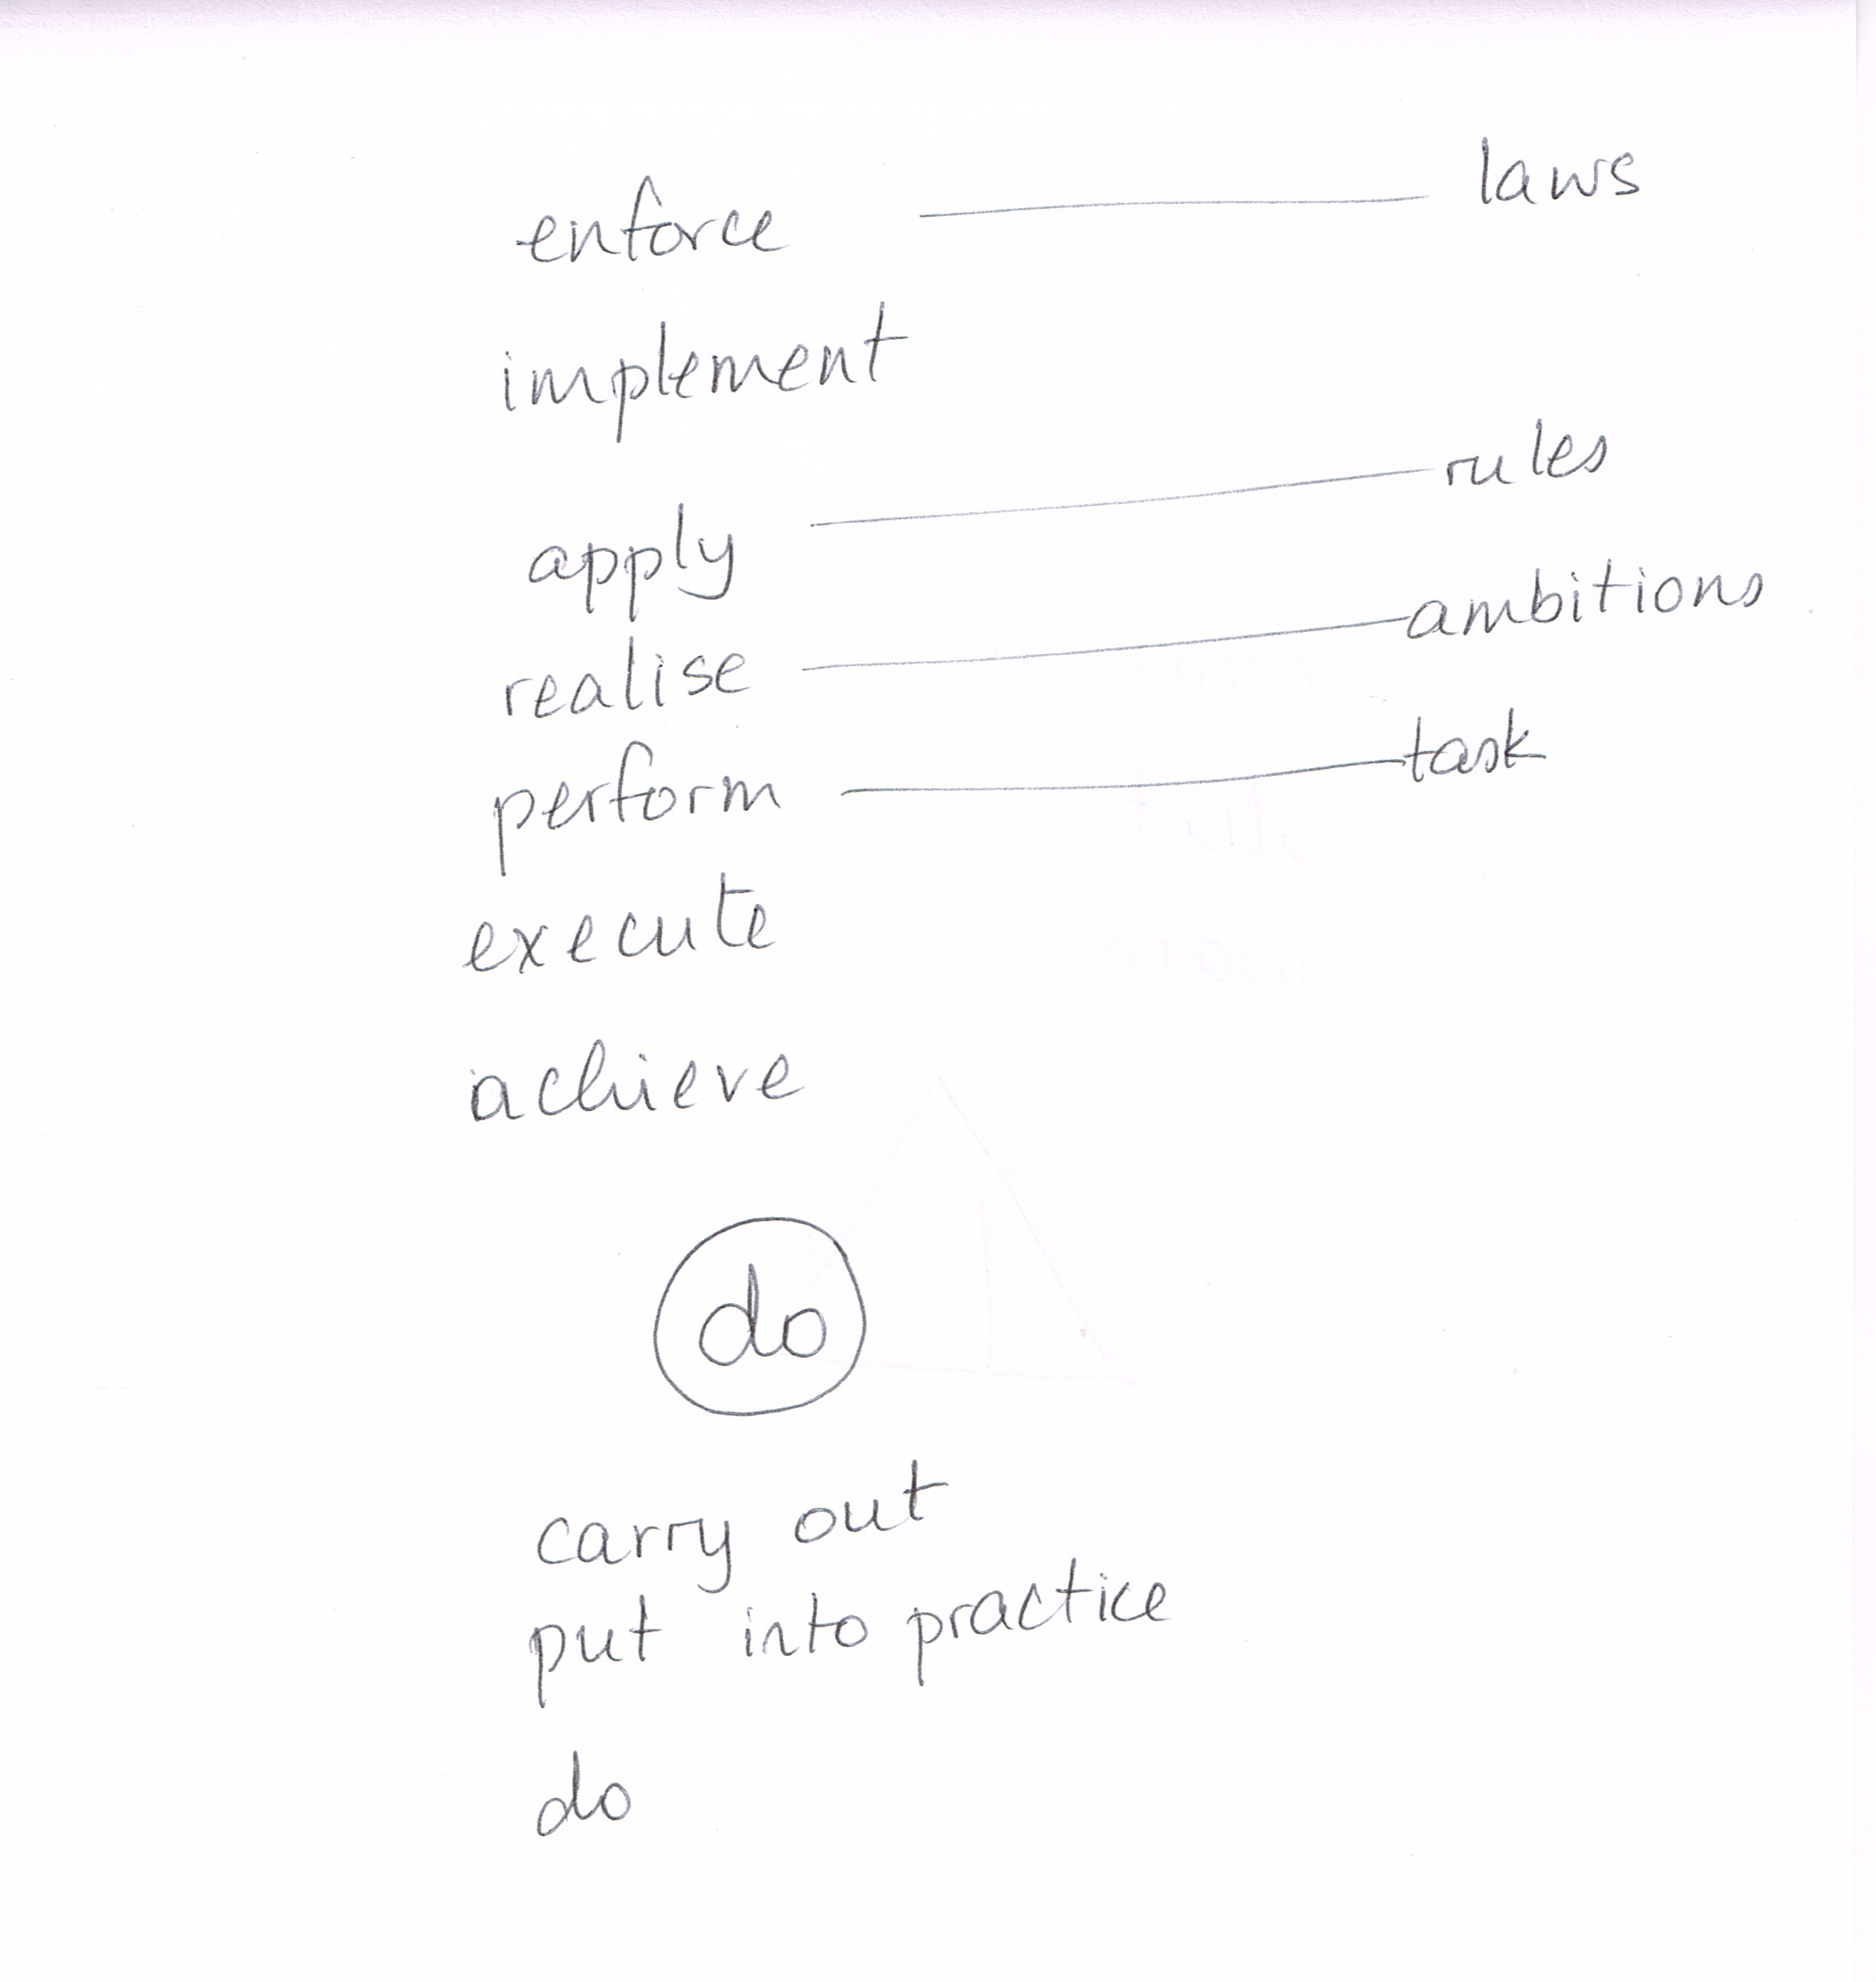

Slide 19
Working on rEGISTER
Detailed guidance on awareness, vocab-building, and activation of formal register in English on my podcast, The Complete Interpreter.
AWARENESS
Shadow someone speaking in a formal style.
Listen to experienced interpreters working in the same kind of setting as you (e.g. if you want to work for EU institutions, listen to European Parliament TV).
Choose an article written in a formal style (e.g. an academic paper, an extract from a book or medical journal) and go through it with a highlighter to identify formal turns of phrase .
Choose two articles on the same subject from two different publications. Read them and compare and contrast their use of language to try to identify instances of formal language.
When creating glossaries or working on vocabulary enhancement, make a note if a term or phrase is particularly informal or formal.
VOCAB-BUILDING
learn a short passage in your B language by heart (suggested by Andy Gillies)
brainstorm formal versions of logical connectors (e.g. 'thus' or 'therefore' instead of 'so')
research and learn stock phrases for certain situations, such as the start of a conference, the beginning of a speech by a politician, etc.
Research more formal verbs, for example in speech transcripts or mission statements
think about phrasal verbs and their single-word equivalents, often derived from Latin (e.g. 'postpone' instead of 'put off')
find neutral and/or formal equivalents for 'good' and 'bad'
brainstorm more formal synonyms for concepts such as go up/go down, make, do, help, change, etc.
ACTIVATION
select 5 or 10 formal words (verbs, nouns, adjectives), research them in a dictionary and collocations dictionary, and invent example sentences to anchor them in your memory.
prepare a speech of your own in your B language, and incorporating some of the formal words you've chosen.
prepare a speech of your own in your B language incorporating formal features (for example, a speech at an inauguration or prize-giving ceremony).
choose a suitable text in your B language, such as a blog post, and rewriting it to make it more formal.
choose a suitable speech in your B language and doing a simultaneous reformulation exercise, making the speech more formal.

Slide 20
SETTING YOURSELF UP FOR SUCCESs WHEN PRACTISING
EX ANTE VS EX POST
Practising by yourself, with no native speaker to give you feedback, requires a very high sensitivity to language (as well as a lot of motivation).
The success of this technique depends on your English skills, analysis, and diagnostic skills.
To improve your chances of success, first pick a topic. Read an article in English, listen to a podcast, or shadow a speech in English on this subject. Then interpret the speech in your A language.
Or read parallel texts on the same subject (i.e. one in your mother tongue, one in English). Write your own short speech in English based on the texts. Then interpret a speech on this topic.

Slide 21
USING AI
Pronunciation:
use a dictation function (e.g. on Word) to see if it recognizes your output.
Ask chatGPT to generate a list of words you struggle with (e.g. ‘small’), then a list of sentences to say out loud.
Grammar: put a transcript of your interpretation through an AI and ask it to correct the grammar.
Sight translation: put a text through DeepL to find useful phrases (careful – often literal).
Reformulation:
Pick a text (B language) for reformulation practice. Ask an AI to rewrite it and compare the output.
Ask e.g. Chat GPT to create a gap-filling exercise for you, e.g. “Create a Cloze test on the subject of elections, based on a 500-word text in which you have blanked out several collocations.”
Put a text through an AI and ask it to make the text more formal/less formal.
Vocabulary-building:
ask an AI (e.g. ChatGPT) to produce a list of common terms in a specific subject, e.g. “Give me a list of collocations relating to elections”.
Ask the AI to create a game to help you learn the collocations (e.g. a matching game).
Use a flashcard app to consolidate new vocabulary/phrases and practise immediate recall (e.g. Quizlet). You can copy/paste whole columns of an Excel spreadsheet. You can even add audio.

Slide 22
ASSESSING YOUR PERFORMANCE
Record your performance when you interpret. Just the output (e.g. voice note on mobile phone), or twin track (Audacity, GarageBand). Listen back, and consider whether the audience has everything it needs. What do you need to improve?
Once in a while, create a transcript of your version and the original (e.g. with sonix.ai or GoReact). Break the original into units of meaning in a table (suggested by Andy Gillies). Align the original with the interpretation. Think about WHY you came up with certain solutions > what coping strategies could you have used? How could you rephrase your output if necessary? Redo the same speech.
For a long time, politics has dealt with the young (Brexit) remainer as it does with the rest of us;
ignore us for long enough, and we’ll go away.
If the Brexit argument had had any foundation
– if it had brought trading or other benefits,
if it had caused only negligible difficulties and those of the teething variety –
then that would probably have worked.

Slide 23
FURTHER READING
https://www.theinterpretingcoach.com/develop-your-retour/
https://www.theinterpretingcoach.com/make-english-work-for-you/
https://www.theinterpretingcoach.com/retour-self-training/
https://www.theinterpretingcoach.com/improve-your-retour-with-native-speaker/
My podcast, The Complete Interpreter, has many episodes dealing with retour.

